Slide 1
Functional interface

Slide 2
What is Functional Interface
A function interface in Java is an interface with only one abstract method. Whereas interfaces from traditional descriptive conventions implement classes, functional interfaces focus on behavior, and allow developers to treat tasks as objects. They form the cornerstone of Java programming features, enabling the use of lambda syntax and style.
Functional Interface is also known as Single Abstract Method Interfaces or SAM Interfaces. It is a new feature in Java, that helps to achieve functional programming approach.

Slide 3
@FunctionalInterface
interface sayable{
void say(String msg);
}
public class FunctionalInterfaceExample implements sayable{
public void say(String msg){
System.out.println(msg);
}
public static void main(String[] args) {
FunctionalInterfaceExample fie = new FunctionalInterfaceExample();
fie.say("Hello there");
}
}

Slide 4
Lambda Expressions and Method References
Functional interfaces shine when combined with lambda expressions and method references. Lambda expressions provide a concise syntax for defining anonymous functions, while method references allow developers to reference existing methods by name.

Slide 5
Predefined-Functional Interfaces
Predefined functional interfaces in Java are part of the java.util.function package and offer a foundation for lambda expressions and method references. These interfaces allow you to write concise, readable, and reusable code by abstracting common functionalities.
1. Predicate<T>
Represents a boolean-valued function.
Method: boolean test(T t)
Example : Predicate<String> isEmpty = String::isEmpty;

Slide 6
Predicate
The Predicate<T> interface is a functional interface introduced in Java 8 as part of the java.util.function package and was introduced in Java 8. It represents a single-argument function that returns a boolean value, often used to test conditions.
Key Characteristics
Single Input: Accepts one input parameter of type T
Boolean Output: Returns a boolean, typically used in conditional statements.

Slide 7
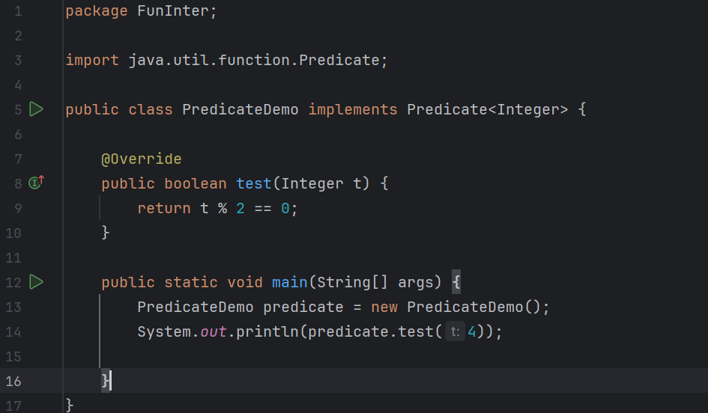

Slide 8
Consumer Interface
The Consumer<T> interface is a functional interface introduced in Java 8 as part of the java.util.function package. It represents an operation that takes a single input argument and performs some action but does not return any result. This can be particularly useful for operations like printing, logging, or modifying an object.
Key Characteristics
Single Input: The Consumer<T> interface accepts one input parameter of type T.
No Return Value: It performs an operation but does not return any result.

Slide 9
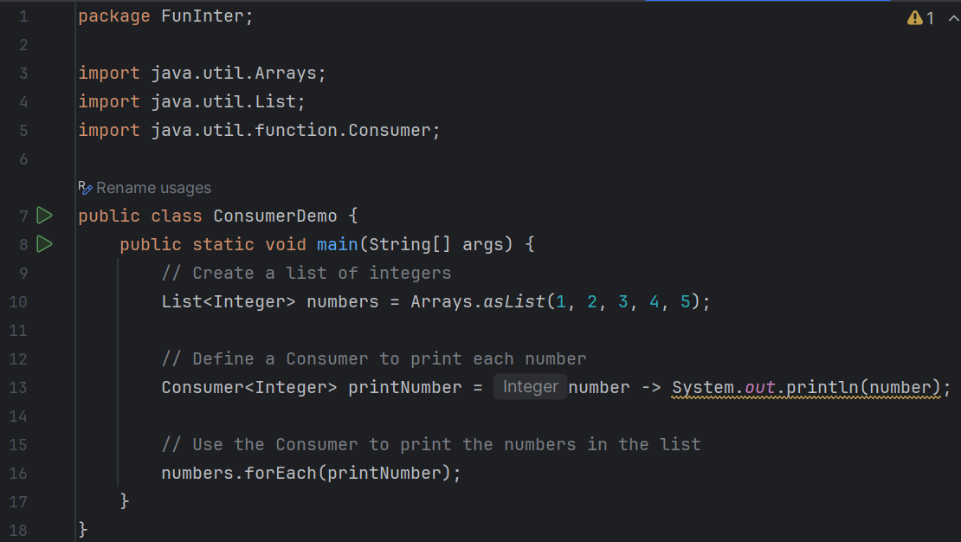

Slide 10
Supplier
The Supplier<T> is a functional interface in Java introduced in Java 8 as part of the java.util.function package. It represents a supplier of results, meaning it takes no arguments but returns a result of type T.
Key Characteristics
No Input: The Supplier<T> interface does not accept any arguments.
Generates a Result: It provides a result of type T.

Slide 11
